Slide 1


Big Data & Business Intelligence workshop Jan 19, 2019
Organized by

Slide 2

Program
About Data science and how to 'Gather, Clean, Store, Process & Visualize' via Azure.
About Big Data projects - Spark, Hadoop, Hive, HBase, Sqoop
Hands On [1] for Storage - Deploy Hadoop + Azure Blob cluster
Hands On [2] for Processing - Deploy Spark and process cluster data
Lunch & Networking
Demystifying importance of SaaS and Visualization in Data science
Hands On [3] for Visualization - Using SaaS BI tool 'Syncfusion Dashboard', design a dashboard and explore BI feature sets
Time for Raffle -> Gift cards!
Photo session
Enjoy the snacks and See you later ☺

Slide 3

Download pre-requisites for HandsOn
Hadoop - https://drive.google.com/open?id=1CjnJ9TQTquIiwhyGN7p_F77MKnhaSDmX
Spark - https://www.apache.org/dyn/closer.lua/spark/spark-2.4.0/spark-2.4.0-bin-hadoop2.7.tgz
(from Spark home page - http://spark.apache.org/downloads.html)
Data – Ensure you have same count of files in this drive link. I have added few more datasets for HandsOn.
https://drive.google.com/drive/folders/1VA5YNv3iJrdv0RmPGBKs-0dLXeyqCsCo

Slide 4

Dinesh Kumar
Product Manager - Data Platform team
Currently handling REST data sources module of Syncfusion Dashboard Cloud
Twitter - @dinuswt22
Email – dinesarun@hotmail.com

Slide 5
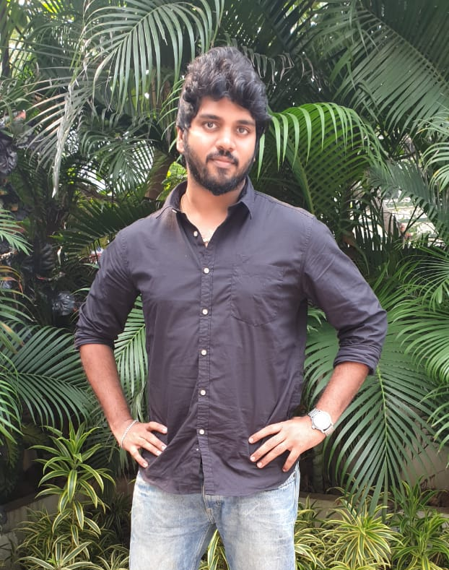
Pragadeesh
Product Manager - Data Platform team
Handling … of Syncfusion Dashboard Cloud
Twitter - @deeshnaran
Email – npragadeeshnaren@gmail.com

Slide 6
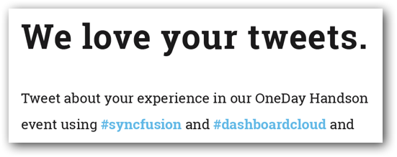

Twitter
@
https://demo.syncfusion.io/bi/en-us/dashboards/d11a9014-b252-42e4-a303-1b11fe864996/Twitter%20live%20demo/Twitter%20live%20demo?showmydashboards=1

Slide 7
Thanks & Enjoy the rest of the Day!

